Slide 1
Linux and Shell Scripting

Slide 2
Learning Outcomes
Understand the basic data structures.

Slide 3
Stacks
Stack: A stack is an ordered list in which all insertions and deletions are made at one end, called the top.

Slide 4

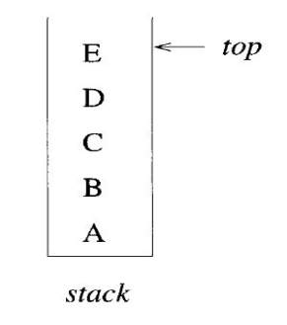
Representation of a stack and queue
Stack follows the LIFO operations.

Slide 5
Representation of a stack by 1-D array
Using a 1-D array.
stack [0 : n-1], where n is the maximum number of allowable entries.
The first or bottom element in the stack is stored at stack [0], the second at stack[1],and the ith at stack[i-1].

Slide 6
Top of the stack
Associated with the array is a variable, typically called top, which points to the top element in the stack.
To test whether the stack is empty, we ask
"if (top < 0)". If not, the topmost element is at stack [top].
Checking whether the stack is full by "if (top > n-1)".

Slide 7
Operations on a stack (Add)
Algorithm Add (item)
// Push an element on to the stack. Return true if successful;
// else return false, item is used as an input.
{
if (top ≥ n - 1) then
{
write (\"Stack is full!\;")return false;
}
else
{
top :=top + 1;
stack[top] :=item;
return true;
}
}

Slide 8
Operations on a stack (Delete)
Algorithm Delete(item)
// Pop the top element from the stack. Return true if successful
// else return false, item is used as an output.
{
if (top < 0) then
{
write (\"Stack is empty!"); return false;
}
else
{
item:=stack[top], top :=top - 1; return true;
}
}

Slide 9
Representation of a stack by links
Use of a pointer.
A node is a collection of data and link information.
A stack can be represented by using nodes with two fields, possibly called data and link.

Slide 10
Representation of a stack by links
Data Field: The data field of each node contains an item in the stack and the corresponding link field points to the node containing the next item in the stack.
Link Field: The link field of the last node is zero, for we assume that all nodes have an address greater than zero.

Slide 11
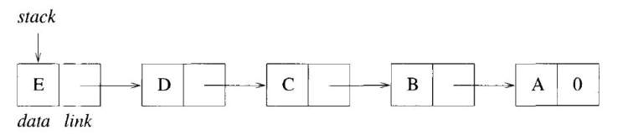
Representation of a stack by links

Slide 12
Type of data
node=record
{
Type data;
node *link;
}

Slide 13
Operations on a stack (Add)
Algorithm Add (item)
{
// Get a new node.
temp:=new node;
if (temp ≠ 0) then
{
(temp → data) :=item;(temp → link) :=top;
top :=temp; return true;
}
else
{
write ("Out of space!”);
return false;
}
}

Slide 14
Operations on a stack (Delete)
Algorithm Delete (item)
{
if (top = 0) then
{
write (\"Stack is empty!”);
return false;
}
else
{
item:=(top → data); temp:= top;
top :=(top → link);
delete temp;
return true;
}
}

Slide 15
Operations on a stack
The variable top points to the topmost node (the last item inserted) in the list.
The empty stack is represented by setting top :=0.
Because of the way the links are pointing, insertion and deletion are easy to accomplish.
In the case of Add, the statement temp := new node; assigns to the variable temp the address of an available node.

Slide 16
Operations on a stack
If no more nodes exist, it returns( ).
If a node exists, we store appropriate values into the two fields of the node. Then the variable top is updated to point to the new top element of the list.
Finally, true is returned. If no more space exists, it prints an error message and returns false.

Slide 17
Operations on a stack
Referring to Delete, if the stack is empty, then trying to delete an item produces the error message "Stack is empty!“ and false is returned.
Otherwise the top element is stored as the value of the variable item, a pointer to the first node is saved, and top is updated to point to the next node.
The deleted node is returned for future use and finally true is returned.

Slide 18
Operations on a stack
The use of links to represent a stack requires more storage than the sequential array stack [0: n – 1] does.
However, there is greater flexibility when using links, for many structures can simultaneously use the same pool of available space.
Most importantly the times for insertion and deletion using either representation are independent of the size of the stack.

Slide 19
Queues
Queue: A queue is an ordered list in which all insertions take place at one end, the rear, whereas all deletions take place at the other end, the front.

Slide 20
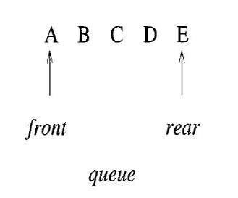
Example of a stack and queue
Queue follows the FIFO operations.

Slide 21
Queue
An efficient queue representation can be obtained by taking an array q[0 : n - 1] and treating it as if it were circular.
Elements are inserted by increasing the variable rear to the next free position. When rear = n - 1, the next element is entered at q[0] in case that spot is free.
The variable front always points one position counterclockwise from the first element in the queue.
The variable front= rear if and only if the queue is empty and we initially set front:=rear := 0.

Slide 22
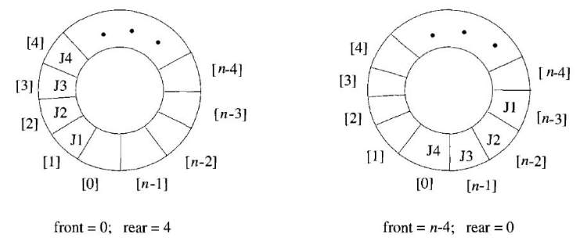
Possible configurations of circular queue

Slide 23
Operation on a queue (Add)
To insert an element, it is necessary to move rear one position clockwise. This can be done using the code
if (rear= n - 1) then rear :=0;
else rear := rear + 1;

Slide 24
Representation of a queue
Another way to represent a queue is by using links.
As with the linked stack example, each node of the queue is composed of the two fields data and link.
A queue is pointed at by two variables, front and rear.
Deletions are made from the front, and insertions at the rear. Variable front= 0 signals an empty queue.

Slide 25
Operation on a queue (Add)
Algorithm AddQ (item)
{
rear :=(rear+ 1) mod n; // Advance rear clockwise.
if (front= rear) then
{
write ("Queueis full!”);
if (front=0) then rear := n-1;
else rear :=rear - 1;
// Move rear one position counterclockwise.
Return false;
}
else
{
q[rear] := item;// Insert new item.
return true;
}
}

Slide 26
Operation on a queue (Delete)
Algorithm Delete Q (item)
{
if (front= rear) then
{
write ("Queue is empty!”);
return false;
}
else
{
front:=(front+ 1) mod n; // Advance front clockwise.
item:=q[front]; //Set item to front of queue.
return true;
}
}

Slide 27
Trees
A tree is a finite set of one or more nodes such that there is a specially designated node called the root and the remaining nodes are partitioned into n > 0 disjoint sets T₁,…,Tn, where each of these sets is a tree. The sets T₁,...,Tn are called the subtrees of the root

Slide 28
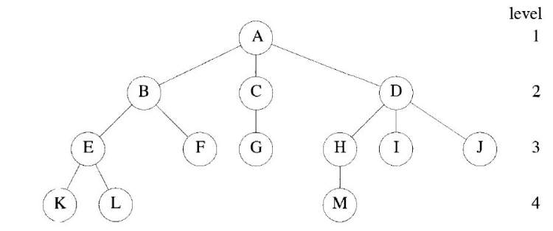
A sample tree

Slide 29
A sample tree
This tree has 13 nodes.
Root contains A.
The number of subtrees of a node is called its degree. The degree of A is 3, of C is 1, and of F is 0.
Nodes that have degree zero are called leaf or terminal nodes. The set {K,L,F,G,M,I,J} is the set of leaf node.
The other nodes are referred to as nonterminals.
Thus the children of D are H, I,and J, and the parent of D is A.

Slide 30
A sample tree
Children of the same parent are said to be siblings. For example H, I, and J are siblings.
The degree of a tree is the maximum degree of the nodes in the tree.
The ancestors of a node are all the nodes along the path from the root to that node.
The ancestors of M are A, D, and H.

Slide 31
A sample tree
The level of a node is defined by initially letting the root be at level one.
If a node is at level p, then its children are at level p + 1.
The height or depth of a tree is defined to be the maximum level of any node in the tree.

Slide 32
A sample tree
A forest is a set of n >0 disjoint trees. The notion of a forest is very close to that of a tree because if we remove the root of a tree, we get a forest.

Slide 33
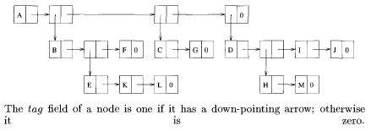
Representation of a tree
We can represent a tree using a fixed node size list structure.

Slide 34
Binary Trees
Any node can have at most two children; that is, there is no node with a degree greater than two.
For binary trees, we distinguish between the subtree on the left and that on the right.
Furthermore, a binary tree is allowed to have zero nodes, whereas any other tree must have at least one node. Thus, a binary tree is really a different kind of object than any other tree.

Slide 35
Binary Trees
A binary tree is a finite set of nodes that is either empty or consists of a root and two disjoint binary trees called the left and right subtrees.

Slide 36
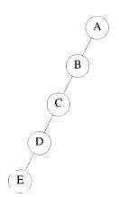
Representation of a binary tree
Left skewed binary tree

Slide 37

Sequential representation of binary tree

Slide 38
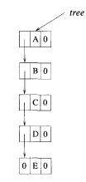
Linked representation

Slide 39
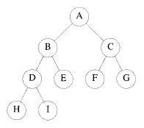
Complete Binary Tree

Slide 40

Sequential representation of binary tree

Slide 41
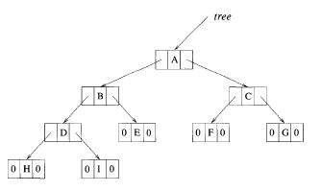
Linked representation

Slide 42
DICTIONARIES
An abstract data type that supports the operations insert, delete, and search is called a dictionary.
Dictionaries have been used in the design of numerous algorithms.

Slide 43
Example
Consider the database of books maintained in a library system. When a user wants to check whether a particular book is available, a search, operation is called for. If the book is available and is issued to the user, a delete operation can be performed to remove this book from the set of available books. When the user returns the book, it can be inserted back into the set.

Slide 44
Binary Search Tree
A binary search tree is a binary tree. It may be empty. If it is not empty, then it satisfies the following properties:
1. Every element has a key and no two elements have the same key (i.e., the keys are distinct).
2. The keys (if any) in the left subtree are smaller than the key in the root.
3. The keys (if any) in the right subtree are larger than the key in the root.
4. The left and right subtrees are also binary search trees.

Slide 45
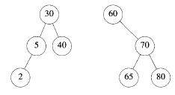
Binary Search Tree
A binary search tree can support the operation search, insert, and delete among others.

Slide 46
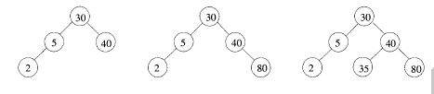
Binary Search Tree

Slide 47
Priority Queues
Any data structure that supports the operations of search min (or max), insert, and delete min (or max, respectively) is called a priority queue.
A max (min) heap is a complete binary tree with the property that the value at each node is at least as large as (as small as) the values at its children(if they exist).

Slide 48
Graphs
The graph G consists of two sets, V and E. The set V is a finite, non-empty set of vertices. The set E is a set of pairs of vertices; these pairs are called edges.
The notations V(G) and E(G) represent the sets of vertices and edges, respectively, of the graph G. We also write G = (V, E) to represent a graph.

Slide 49
Graphs
In an undirected graph, the pair of vertices representing any edge is unordered.
Thus, the pairs(u, v) and (v, u) represent the same edge.
In a directed graph, each edge is represented by a directed pair (u, v); u is the tail and v the head of the edge. Therefore, (v, u) and (u, v) represent two different edges.

Slide 50
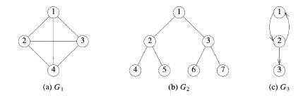
Graphs

Slide 51

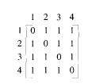
Adjacency matrices of graphs

